Slide 1

A Hands-on Introduction to Machine Learning
1. Teaching Computers to Write Programs

Slide 2
What is machine learning?
Things learn when they change their behavior in a way that makes them perform better in the future.
Arthur Samuel: the goal of machine learning is to give “computers the ability to learn without being explicitly programmed.”

Slide 3
Our definition
Tom Mitchell: A computer program is said to learn from experience E with respect to some class of tasks T and performance measure P if its performance at tasks in T, as measured by P, improves with experience E.

Slide 4
AI vs. ML
ML – a subset of AI
What’s in AI and not in ML? Areas of knowledge representation, constraint optimization, logical and probabilistic reasoning, and planning.
AI is about getting systems to perform tasks that typically require human cognition and decision-making abilities.

Slide 5
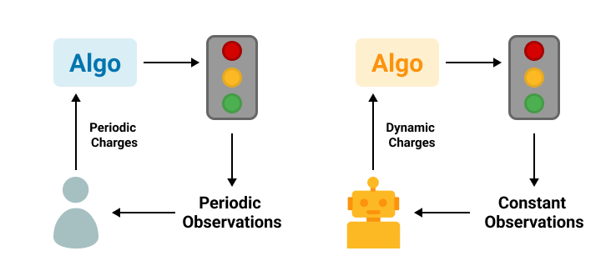
Running a system with ML and without ML

Slide 6
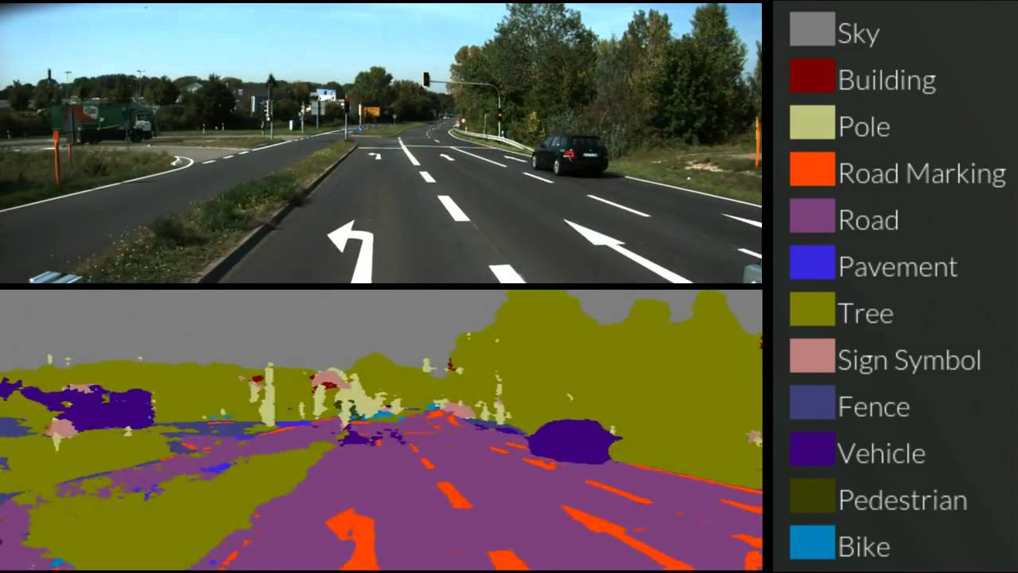
ML in practice example: self-driving car

Slide 7
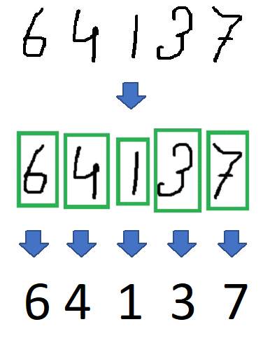
ML in practice example: OCR

Slide 8
ML practice: collaborative filtering
 |  | Movie Name
 |  | Sherlock Holmes | Avengers | Titanic | La La Land | Wall-E
Rating | Person 1 | 4 | 5 | 3 | 4 | 2
 | Person 2 | 3 | 4 | 3 | 2 | 4
 | Person 3 | 2 | 3 | 4 | 5 | 3
 | Person 4 | 3 | 4 | 4 | 5 | 2
 | Person 5 | 4 | ? | 3 | ? | 4

Slide 9
ML practice: content filtering
 |  | Characteristics
 |  | Rating | Year | Genre | Lead
Movies | Sherlock Holmes | 4 | 2009 | Action | Robert Downy, Jr.
 | Avengers | ? | 2012 | Action | Robert Downy, Jr.
 | Titanic | 3 | 1997 | Drama | Leonardo DiCaprio
 | La La Land | 2 | 2016 | Comedy | Ryan Gosling
 | Wall-E | 4 | 2008 | Animation | Ben Burtt

Slide 10
Branches of ML

Slide 11
Skills for ML
Math
Programming
Computer and data literacy
ML algorithms
Critical thinking

Slide 12
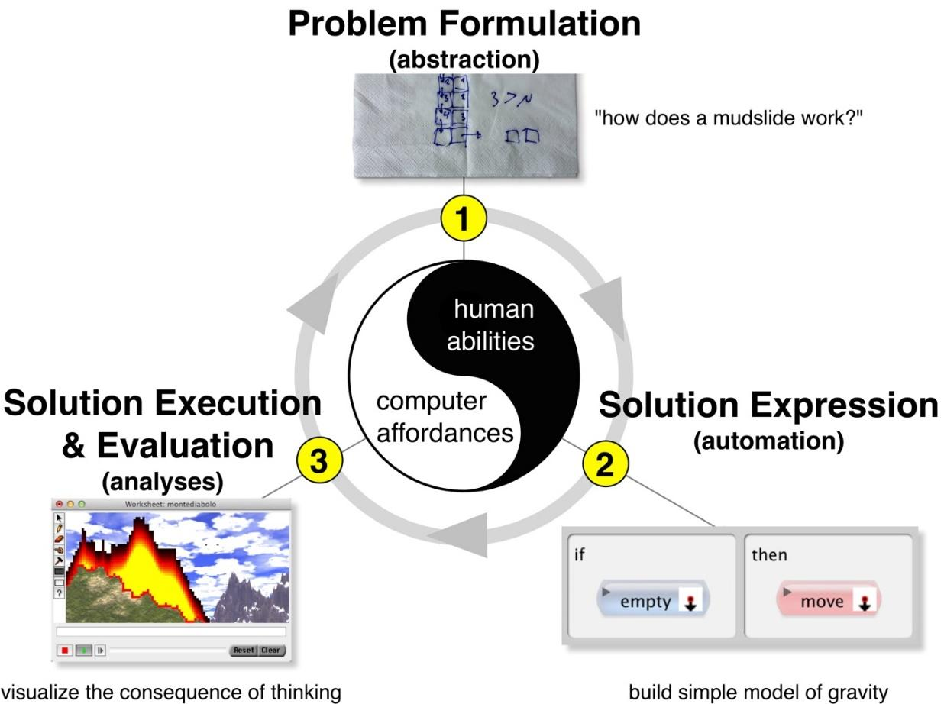
Computational thinking

Slide 13
Summary
Machine learning (ML) is a subset of artificial intelligence (AI)
Learning involves change, typically in a positive direction. What that means is with more learning (change), we should get better at performing the given task we are supposedly learning. This applies to humans as well as machines.
Branches of ML: supervised, unsupervised, reinforcement

